Slide 1
Define Your
PRIME

Slide 2
Tod Pettus Transformation short video without check presentation (or anyone of the Grand Prize Prime Challenge Transformation videos could be shown here)

Slide 3
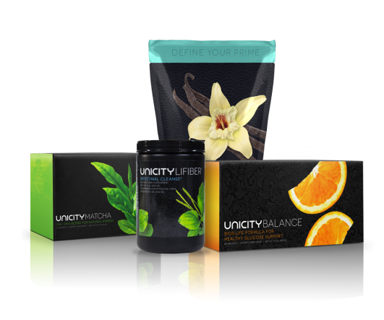
TOD
STATS
Weight:
Down 35.2 lbs
Waist:
33 - 28
Cholesterol:
163 - 107
LDL:
98 - 57
HDL:
38 - 46
Triglycerides:
136 - 23
Blood Press:
134/84-108/64
Heart Rate:
84 – 51 BPM
BEFORE
AFTER

Slide 4
Why
?
Why
NOW?

Slide 5
Notes:
More than 100 million people in the U.S. (one-third of the population) are diabetic or prediabetic

Slide 6
Notes:
nearly 70% of Americans are obese or overweight

Slide 7
Notes:
cardiovascular diseases account for one-third of all deaths.

Slide 8
Notes:
Not only are weight-loss, diabetes, and cardiovascular the fastest growing health concerns, but they also comprise the biggest health markets. All told, they are on track to total nearly $200 billion a year.
We’re not the only ones looking at this market. All of the pharmaceutical companies, like Abbot, Merck, GlaxoSmithKline, Roche, and Pfizer are actively looking for solutions. Weight loss companies like Nutri-Systems, Jenny Craig and Weight Watchers continue to grow, and food manufacturers are constantly looking for diabetic-friendly formulas, heart-healthy foods, and “skinny” snacks.

Slide 9
Play Richard Madsen “fix it” video

Slide 10
RICHARD
STATS
Weight:
Down 47 lbs
Waist:
43 - 35
Cholesterol:
194 - 159
LDL:
145 - 95
HDL:
36 - 53
Triglycerides:
66 - 54
Blood Press:
143/83 – 109/73
Heart Rate:
72 – 53 BPM
BEFORE
AFTER

Slide 11
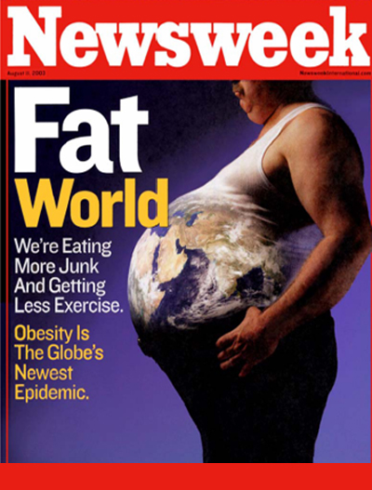
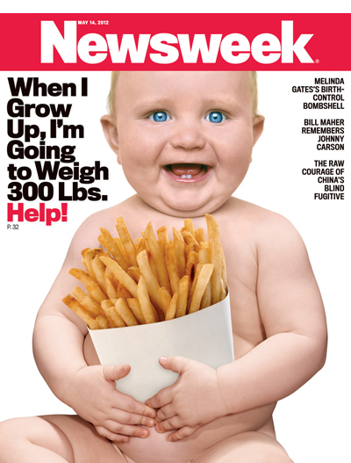
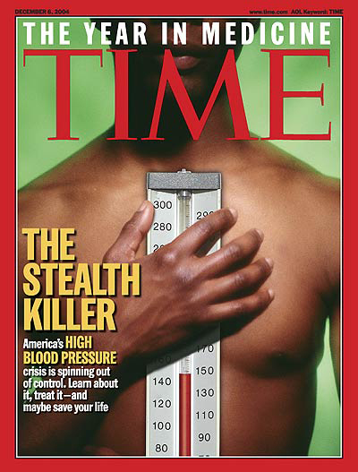
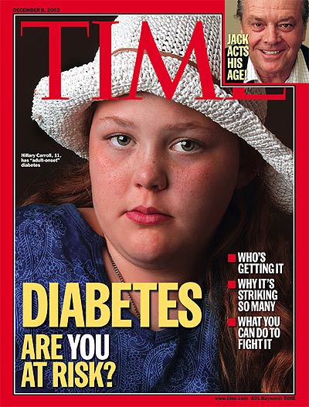
Problem
Solution
Products
Leading Science
World Class Quality
Highest Efficacy

Slide 13
16
Notes:
Each of Unicity’s products are subject to meticulous research and development, and several are listed in the prestigious Physicians’ Desk Reference—a resource used often by doctors to learn about prescription drugs and clinically proven alternatives. Unicity has also collaborated with major medical institutions including: The Cleveland Clinic, The American Heart Association, The American Diabetes Association, University of Utah, University of Minnesota, and Columbia University.

Slide 14
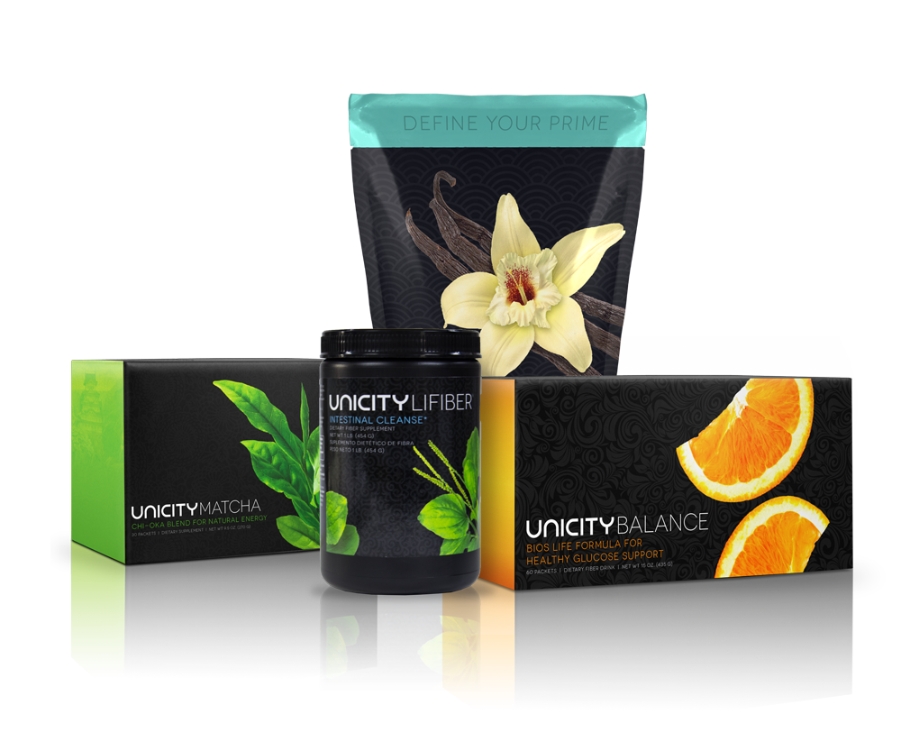
Prime Health Pack

Slide 15
Play Products Video from defineyoury.com Note: show either product video or the following product slides, but not both

Slide 16
Notes:
Complete is a high-end protein meal replacement to ensure a fit, energized, and well-nourished body. Whether blended each morning with fresh fruit, or shaken up with a nice tall glass of milk, two scoops of Complete will help:
Provide 20 grams of high-quality protein, as well as beneficial fiber, to keep you feeling full, build lean muscle mass, and provide energy without causing large spikes in insulin
Ensure you’re getting 100% of your recommended daily intake for many essential vitamins and minerals
A delicious meal replacement, Complete infuses your body with high-quality protein—as well as natural fibers, vitamins, and minerals. With only the best ingredients, Complete sustains your body with the daily fuel you need and helps jumpstart your metabolism. This careful combination will build lean muscle and build your life.

Slide 17
Why
COMPLETE?
High Protein Meal Replacement
Daily for Breakfast
20 Grams of Protein
Delicious & Low in Carbohydrates
100% Daily Vitamins & Minerals
Builds Lean Muscle
Vanilla, Chocolate, and Vegan
Notes:
Complete is a high-end protein meal replacement to ensure a fit, energized, and well-nourished body. Whether blended each morning with fresh fruit, or shaken up with a nice tall glass of milk, two scoops of Complete will help:
Provide 20 grams of high-quality protein, as well as beneficial fiber, to keep you feeling full, build lean muscle mass, and provide energy without causing large spikes in insulin
Ensure you’re getting 100% of your recommended daily intake for many essential vitamins and minerals
A delicious meal replacement, Complete infuses your body with high-quality protein—as well as natural fibers, vitamins, and minerals. With only the best ingredients, Complete sustains your body with the daily fuel you need and helps jumpstart your metabolism. This careful combination will build lean muscle and build your life.

Slide 18
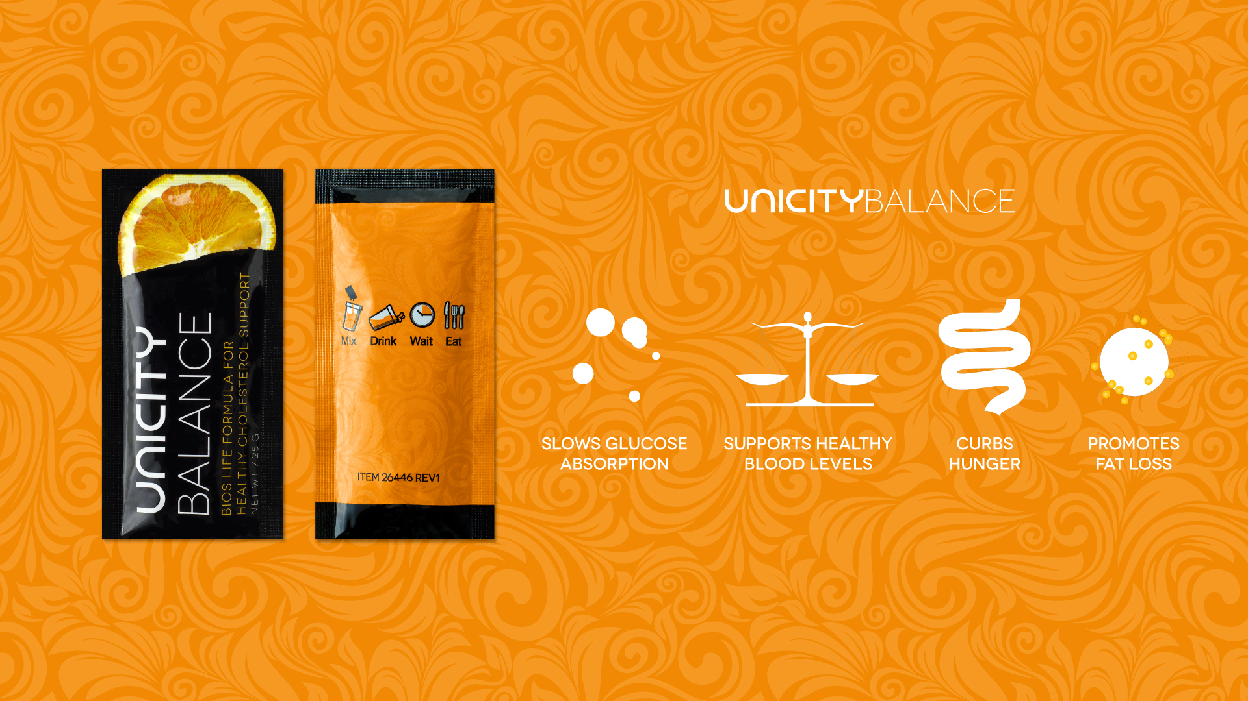
Notes:
The first product in the Prime Health Pack, UNICITYBALANCE, is a natural supplement designed to burn fat by managing glucose and cholesterol. It has an enduring, medically proven track record of success in helping people gain control of their bodies, and ultimately their lives. Taking Balance correctly and consistently will help:
Curb hunger so you eat less and feel full longer
Promote optimal fat loss
Slow glucose absorption into the blood stream
Offset the carbohydrates you eat
Support healthy cholesterol and triglyceride levels

Slide 19
Why
BALANCE?
Burns Fat – Reducing Inches
Improves Digestive Issues
Normalizes Blood Sugar
Lowers Triglycerides / Blood Lipids
Balances Cholesterol Levels
All Natural – Safe for Children
Controls Glycemic Response
Curbs Hunger
Notes:
The first product in the Prime Health Pack, UNICITYBALANCE, is a natural supplement designed to burn fat by managing glucose and cholesterol. It has an enduring, medically proven track record of success in helping people gain control of their bodies, and ultimately their lives. Taking Balance correctly and consistently will help:
Curb hunger so you eat less and feel full longer
Promote optimal fat loss
Slow glucose absorption into the blood stream
Offset the carbohydrates you eat
Support healthy cholesterol and triglyceride levels

Slide 20
Notes:
Matcha, which is a Chi-Oka blend rich in antioxidants and other vital nutrients, provides a natural source of energy and improved mental clarity. Whenever you need it, enjoy a drink of Matcha to help:
Increase alertness and focus
Add vitality and harmony to your mind and body
Relieve stress and improve concentration
Contribute to normal, energy-yielding metabolism
Contribute to the protection of cell constituents from oxidative damage

Slide 21
Why
MATCHA?
Maintains Healthy Blood Sugar
Improves Mental Focus
Maintains Electrolyte Balance
Increases Thermogenesis
BURNS FAT
High Antioxidant Source
Notes:
Matcha, which is a Chi-Oka blend rich in antioxidants and other vital nutrients, provides a natural source of energy and improved mental clarity. Whenever you need it, enjoy a drink of Matcha to help:
Increase alertness and focus
Add vitality and harmony to your mind and body
Relieve stress and improve concentration
Contribute to normal, energy-yielding metabolism
Contribute to the protection of cell constituents from oxidative damage

Slide 22
PRIME
TRANSFORMATION

Slide 23
A 12-week program to your physical PRIME

Slide 24
Play Transformation video from defineyoury.com

Slide 25
100% Money Back Guarantee!
95% Completion Rate!
100% SUCCESS Rate!

Slide 26
90 Days of
Products
What do you GET:

Slide 27
One on One
WEEKLY Coaching

Slide 28
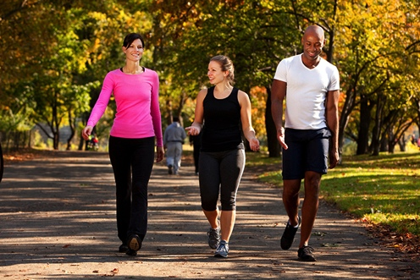
Personal
SUPPORT Group

Slide 29
Show Prime Challenge from defineyoury.com

Slide 30
Don’t Just
Don’t Just
Define Your
PRIME
Define Your
PRIME
ACHIEVE YOUR PRIME!

Slide 31
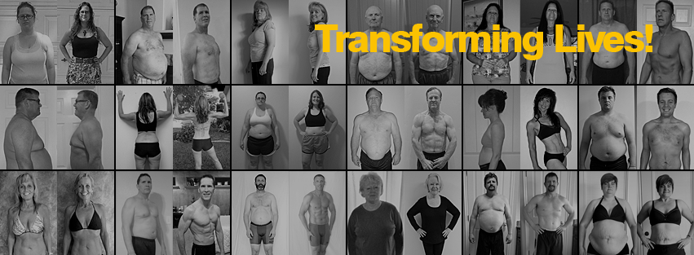
Thousands of PRIME TRANSFORMATION Graduates

Slide 32
Note: Before and After pictures
There is not enough time to show all the before and after slides. Select 10 – 15 of your favorite and highlight one key point on each. The goal is to show a selection of genders, age, fitness level and nationality.

Slide 33
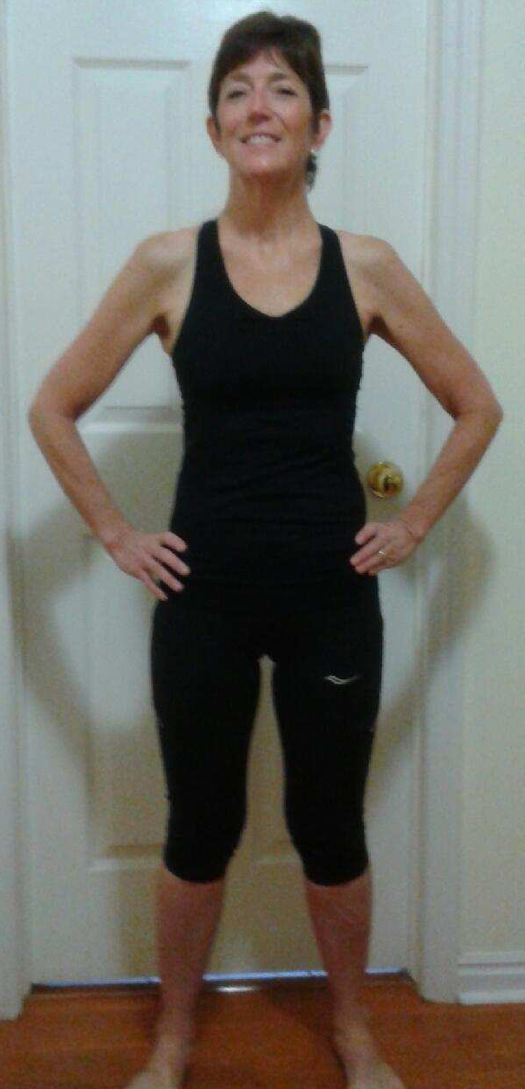
CHARLIE
STATS
Weight:
Down32 lbs.
Waist:
Down 8”
Hips:
Down 5”
Chest:
38 - 33
Dress Size:
12 - 2
BEFORE
AFTER

Slide 34
MATT
STATS
Weight:
Down 40.5 lbs
Waist:
Down 9.5”
HbA1C:
7.1 – 6.4 pts.
BEFORE
AFTER

Slide 35
APRIL
STATS
Weight:
Down 27 lbs
Body Fat:
Down 18%
Waist:
Down 8”
Hips:
Down 6.5”
Cholesterol:
144-129
BEFORE
AFTER

Slide 36
BRIAN
STATS
Weight:
Down 41 lbs
Body Fat:
Down 17%
Waist:
Down 4.5”
Belly:
Down 9”
Cholesterol:
186 - 143
Triglycerides:
90-52
BEFORE
AFTER

Slide 37
Dr ANDRUSS
STATS
Weight:
Down 16 lbs
Waist:
34 - 27
Hips:
Down 3”
LDL:
Down
HDL:
Up
Triglycerides:
Down
Blood Press:
Down
BEFORE
AFTER

Slide 38
CODY
STATS
Weight:
Down 30 lbs
Waist:
Down 5.5”
Body Fat:
26% - 17%
Cholesterol:
154 - 132
LDL:
83 - 77
HDL:
28 - 34
Triglycerides:
214 - 106
16 years old
BEFORE
AFTER

Slide 39
BILLY
STATS
Weight:
Down 44 lbs
Body Fat:
Down 14%
Triglycerides:
Down 269
BEFORE
AFTER

Slide 40
PAKI
STATS
Weight:
Down 87 lbs
Stomach:
70 – 48
Neck:
24 – 18
Thighs:
47 – 30
BEFORE
AFTER

Slide 41
JUDY
STATS
Weight:
Down 24 lbs
Cholesterol:
207-189
LDL:
139 - 119
HDL:
45 - 51
Triglycerides:
117 - 97
BEFORE
AFTER

Slide 42
TONY
STATS
Weight:
Down 51 lbs
Cholesterol:
307 - 141
LDL:
UM - 83
HDL:
29 - 41
Triglycerides:
931 - 84
Risk Ratio:
10.6 – 3.4
HbA1C:
7.5 – 6.5
BEFORE
AFTER

Slide 43
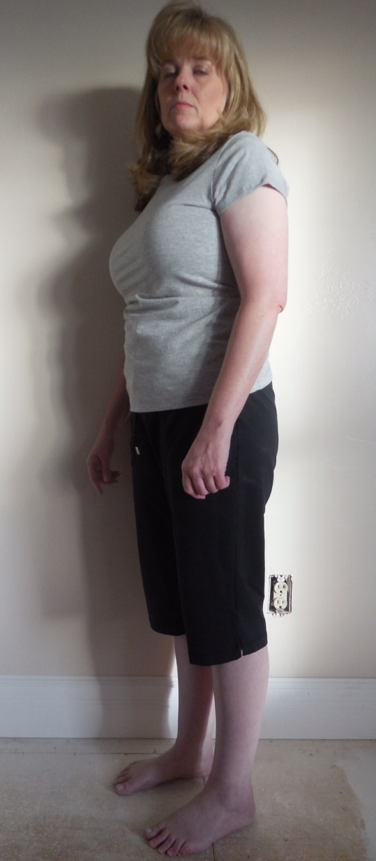
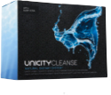
TANNA
STATS
Weight:
Down 20.4 lbs
Waist:
Down 5.5”
Body Fat:
7% pts.
Cholesterol:
179 - 147
HbA1c:
5.6 – 5.2
BEFORE
AFTER

Slide 44
KELLY
STATS
Weight:
Down 20 lbs
Waist:
Down 5”
Neck:
Down 2”
Body Fat:
Down 10%
Cholesterol:
Down 15%
Triglycerides:
Down 15%
BEFORE
AFTER

Slide 45
MARIANNE
STATS
Weight:
Down 25 lbs
Body Fat:
Down 18%
Waist:
Down 3”
Hips:
Down 4.5”
LDL:
109 - 85
HDL:
67 - 94
HbA1C:
5.8 – 5.6
BEFORE
AFTER

Slide 46
JUSTIN
STATS
Weight:
Down 53 lbs
Body Fat:
Down 9%
Waist:
Down 9”
Neck:
Down 3”
BEFORE
AFTER

Slide 47
RANDEE
STATS
Weight:
Down 24 lbs
Waist:
Down 5”
HbA1c:
8.5 – 6.0
Cholesterol:
189 - 139
LDL:
95 -70
HDL:
36 -41
Triglycerides:
289 – 142
BEFORE
AFTER

Slide 48
EDDIE
STATS
Weight:
Down 37 lbs
Waist:
Down 6”
Body Fat:
8% pts.
Cholesterol:
185 - 139
LDL:
135 - 82
HDL:
26 - 46
Triglycerides:
121 - 56
BEFORE
AFTER

Slide 49
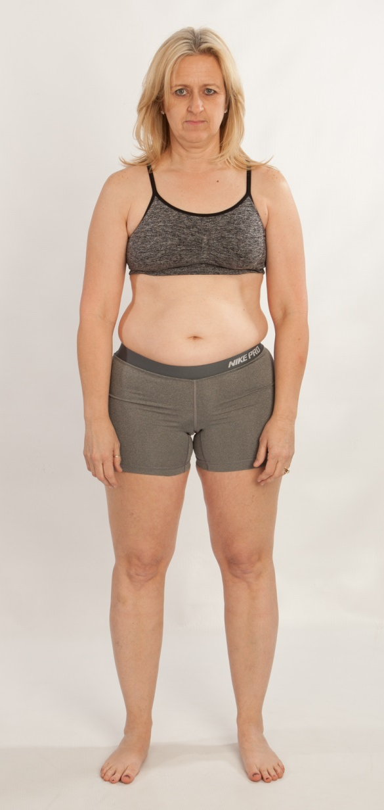
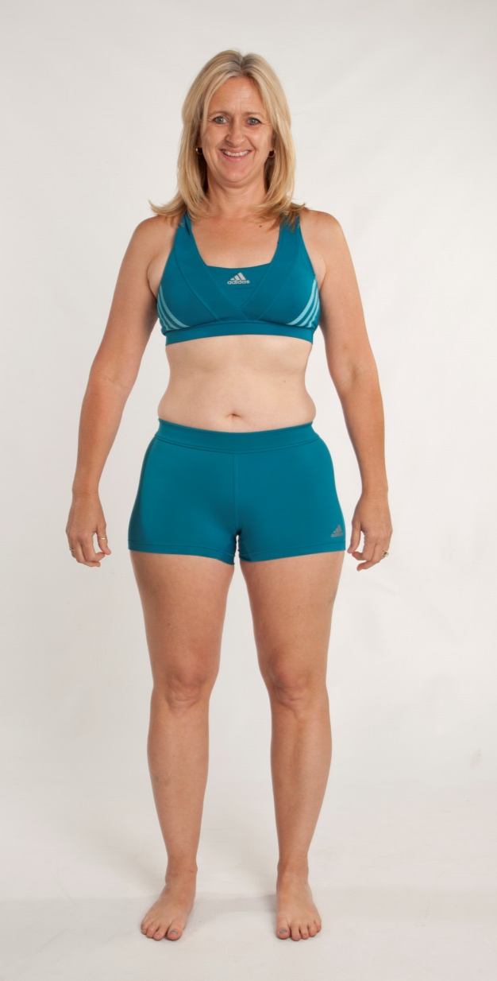
RHONDA
STATS
Weight:
Down 25 lbs
Waist:
Down 5”
Hips:
Down 4.5”
Cholesterol:
211 - 170
LDL:
118 - 86
Triglycerides:
87 -75
BEFORE
AFTER

Slide 50
KIRK
STATS
Weight:
Down 52 lbs
Waist:
Down 12”
Body Fat:
Down 12%
LDL:
Down 14
HDL:
Up 10
Triglycerides:
Down 169
HbA1C:
7.0 – 5.6
No longer Medically
Considered Diabetic
BEFORE
AFTER

Slide 51
TOREY
STATS
Weight:
Down 19 lbs
Body Fat:
Down 11%
Waist:
Down 4.25”
Hips:
Down 4.75”
BEFORE
AFTER

Slide 52
ZACH
STATS
Weight:
Down 63 lbs
Cholesterol :
31 pts.
Body Fat:
15% pts.
BEFORE
AFTER

Slide 53
HEATHER
STATS
Weight:
Down 42 lbs
Waist:
Down 8”
Body Fat:
12% pts.
BEFORE
AFTER

Slide 54
MIKE
STATS
Weight:
162 – 147 .
Body Fat:
23% - 11%
Waist:
36.5 – 29.5
Hips:
38.5 - 34
Cholesterol:
219 - 200
Triglycerides:
101 - 67
LDL:
149 - 131
HDL:
50 - 576
BEFORE
AFTER

Slide 55
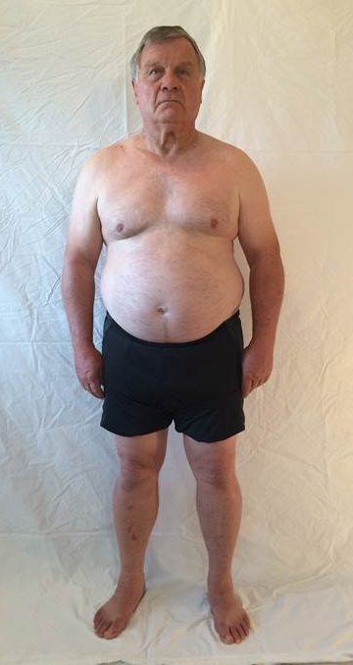
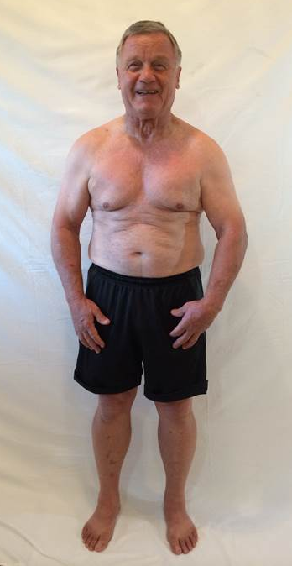
KENT
STATS
Weight:
Down 44 lbs.
Body Fat:
32% - 20%
Waist:
Down 5.75”
HbA1c:
5.2 – 5.1 ”
BEFORE
AFTER

Slide 56
DEANN
STATS
Weight:
Down 32.8 lbs.
Body Fat:
47% - 37%
Waist:
Down 5”
Hips:
Down 5”
Cholesterol:
204-162
Triglycerides:
118 - 57
LDL:
130 - 94
HDL:
50 - 57
HbA1c:
5.5 – 5.3
BEFORE
AFTER

Slide 57
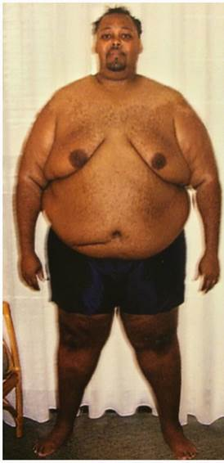
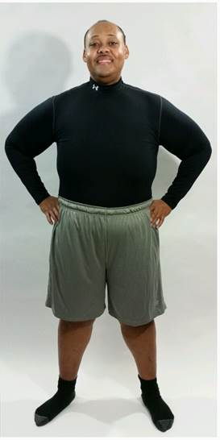
ANDRE
STATS
Weight:
Down 100 lbs.
Body Fat:
49% - 35%
Waist:
Down 18”
Hips:
Down 17.5”
Cholesterol:
193-149
Triglycerides:
80 - 54
LDL:
116 - 88
HDL:
44 - 57
Glucose:
82 - 69
BEFORE
AFTER

Slide 58
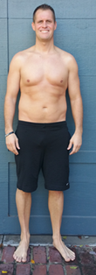
MIKE
STATS
Weight:
Down 43.6 lbs.
Body Fat:
36% - 20%
Waist:
Down 12.5”
Hips:
Down 7”
Triglycerides:
112 - 78
BEFORE
AFTER

Slide 59
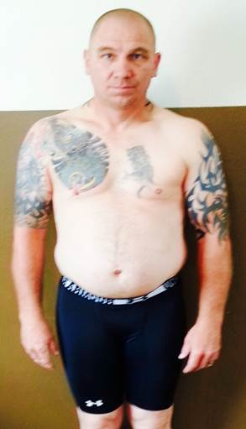
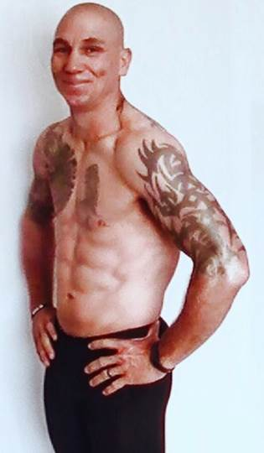
JERRY
STATS
Weight:
Down 31 lbs.
Body Fat:
32% - 10%
Waist:
Down 14.75”
Hips:
Down 12”
Cholesterol:
183 - 159
Glucose:
102 - 88
LDL:
130 - 92
HDL:
42 - 52
HbA1c:
5.2 – 4.7
BEFORE
AFTER

Slide 60
KYLIE
STATS
Weight:
Down 24.3 lbs.
Body Fat:
32% - 11%
Waist:
Down 9”
Hips:
Down 6”
Cholesterol:
240 - 185
Triglycerides:
81 - 55
LDL:
163 - 98
HDL:
61 - 76
HbA1c:
5.7 – 5.2
BEFORE
AFTER

Slide 61
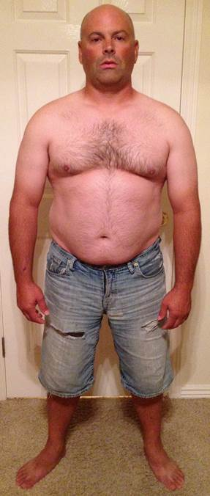
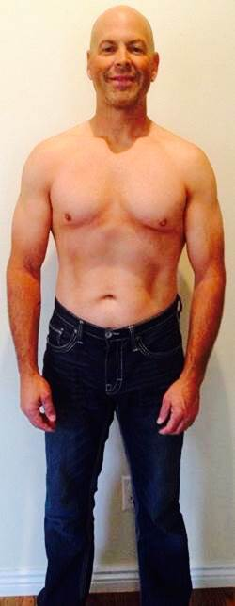
KENT
STATS
Weight:
Down 50 lbs.
Body Fat:
31.2% - 20%
Waist:
Down 9”
Hips:
Down 3.5”
Cholesterol:
220-194
Triglycerides:
165 - 57
LDL:
144 - 123
HDL:
43 - 60
HbA1c:
5.5 – 5.2
BEFORE
AFTER

Slide 62
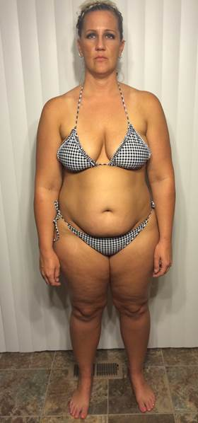
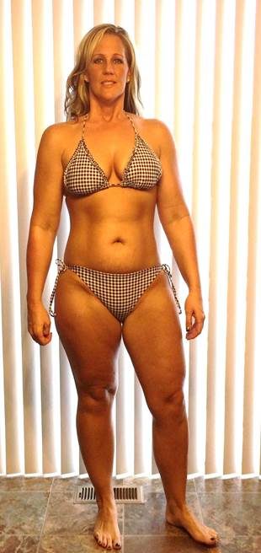
STEPHANNIE
STATS
Weight:
Down 40 lbs.
Body Fat:
51% - 30%
Waist:
Down 9.5”
Hips:
Down 11”
Cholesterol:
183 -169
Triglycerides:
118 - 57
Glucose:
89 - 86
HDL:
40 - 43
HbA1c:
5.3 – 5.2
BEFORE
AFTER

Slide 63
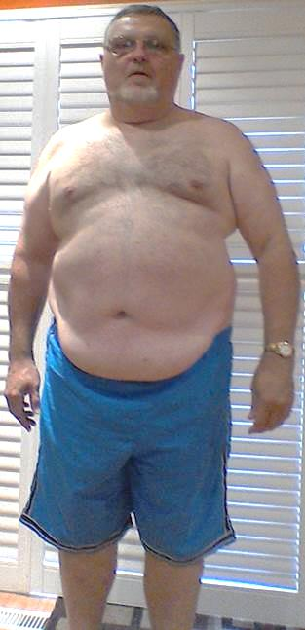
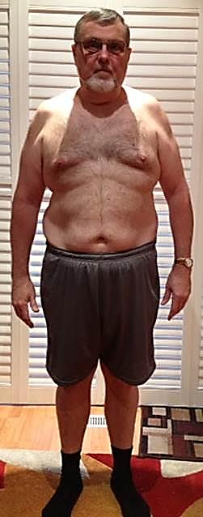
COLIN
STATS
Weight:
Down 45 lbs.
Body Fat:
39% - 34%
Waist:
Down 6”
Hips:
Down 6.5”
Cholesterol:
133 - 127
Triglycerides:
90 - 71
LDL:
78 - 66
HDL:
37 - 46
HbA1c:
6.1 – 5.2
BEFORE
AFTER

Slide 64
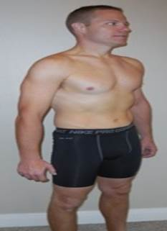
JEREMY
STATS
Weight:
Down 37.2 lbs.
Body Fat:
22% - 15%
Waist:
Down 5.5”
Hips:
Down 5.5”
Cholesterol:
245 - 193
Triglycerides:
150 - 69
LDL:
177 - 137
HDL:
38 - 42
HbA1c:
5.8 – 5.5
BEFORE
AFTER

Slide 65
NANCY
STATS
Weight:
Down 30 lbs.
Body Fat:
36% - 22%
Waist:
Down 8”
Hips:
Down 7”
Cholesterol:
215 - 182
HbA1c:
5.8 – 5.6
BEFORE
AFTER

Slide 66
LILLIAN
STATS
Weight:
Down 8 lbs.
Body Fat:
25% - 18%
Waist:
Down 2.5”
Hips:
Down 4”
Cholesterol:
180-172
BEFORE
AFTER

Slide 67
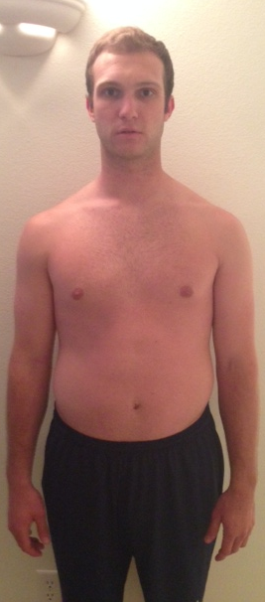
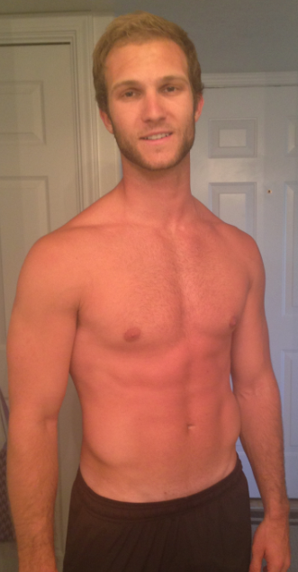
RYAN
STATS
Weight:
Down 11 lbs.
Waist:
Down 1”
Cholesterol:
170 -154
Triglycerides:
132 - 115
HDL:
56 - 66
BEFORE
AFTER

Slide 68
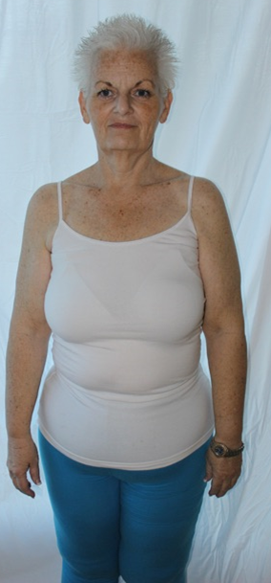
REBECCA
STATS
Weight:
Down 11lbs.
Body Fat:
37% - 25%
Waist:
Down 6”
Hips:
Down 4.5”
Cholesterol:
155 -130
LDL:
76 - 56
BEFORE
AFTER

Slide 69
ROD
STATS
Weight:
Down 36 lbs.
Cholesterol:
167 - 133
Waist:
Down 6”
Triglycerides:
132 - 77
LDL:
84 - 69
BEFORE
AFTER

Slide 70
MARK
STATS
Weight:
Down 61 lbs.
Body Fat:
38% - 20%
Waist:
Down 8”
Triglycerides:
240 - 73
BEFORE
AFTER

Slide 71
Show “Next Step Video” from defineyoury.com

Slide 72
Define Your
PRIME
Define Your
PRIME
DON’T JUST DEFINE IT ACHIEVE IT!
Simply Get Back With The Person Who Invited You Here!
Notes:
So let’s talk about the different ways to get started

